Slide 1
Blackcat Attacks
Prepared By: Aawan Adhikari
Prabin Bhandari
Unit Tutor: Clinton Hayes

Slide 2
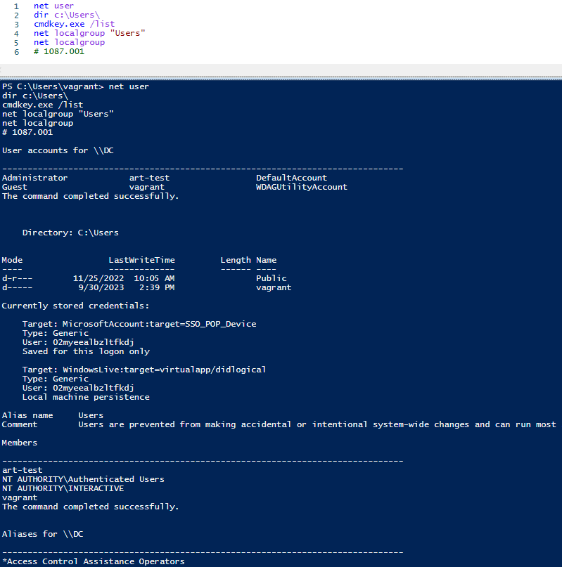
Attack 1087.001
This the code for Black Cat attack T1087.001.
The code was taken from Atomic red team Library.
After checking some accounts, and credential locations, the command completes successfully.

Slide 3
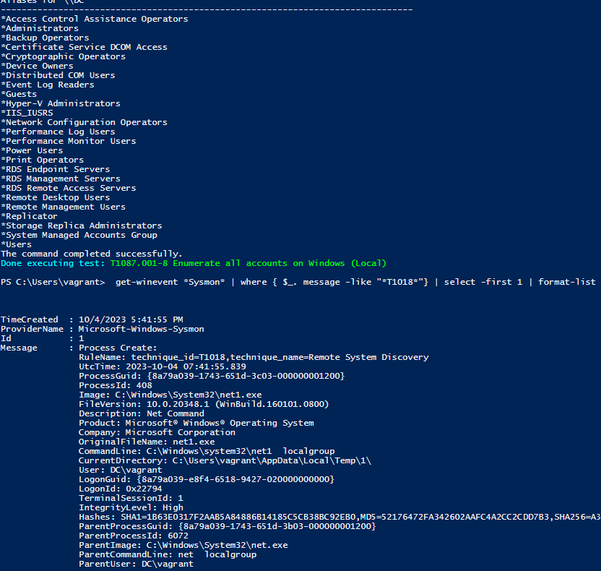
Sysmon Event
Short for System Monitor Event, Sysmon monitors the activities in the System’s Event log. Here Sysmon is Monitoring Wazuh Alert 1087.
A code for activating Sysmon is:
get-winevent *Sysmon* | where { $_. message -like "*T1018*"} | select -first 1 | format-list

Slide 4
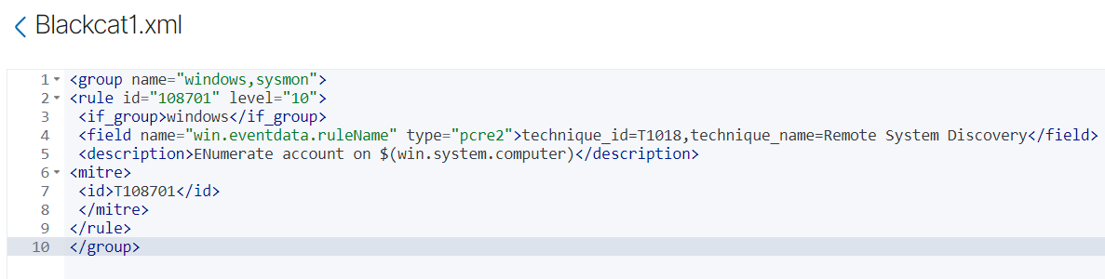
XML Rule File
By Saving this rule in Wazuh, if some events are happening in the system that can trigger this rule, it will show the alert in the security events.
By making some changes in the rules like changing the attack number, we can generate alerts for different attacks.

Slide 5
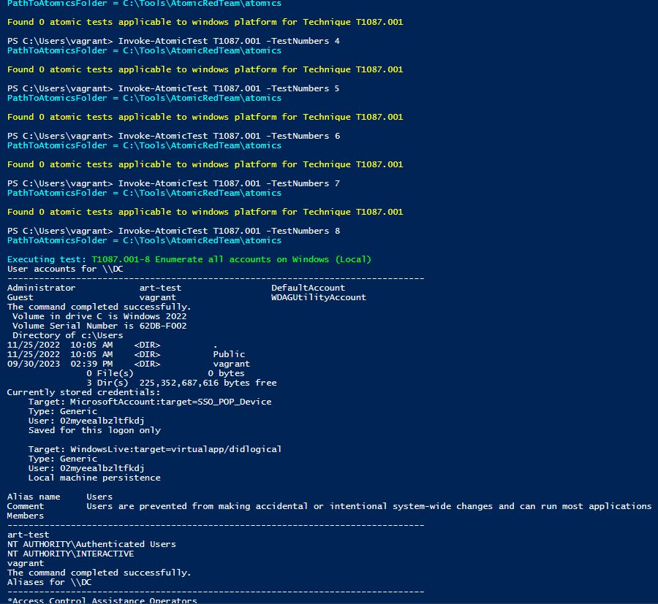
Invoking
By Invoking a certain part of a certain attack, we can emulate an attack that will generate an alert in Wazuh. Here, Multiple sections were not generating any attacks. After Trying multiple numbers, Test Number 8 was able to invoke the system and emulate the attack. More information of Invoke can be found on the next slide.

Slide 6
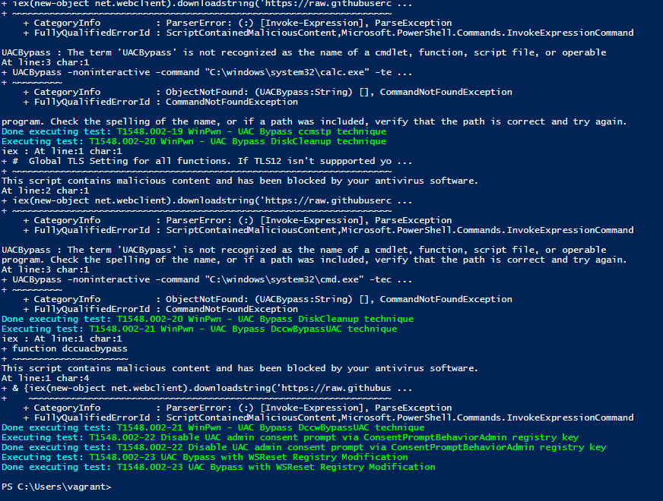

Slide 7
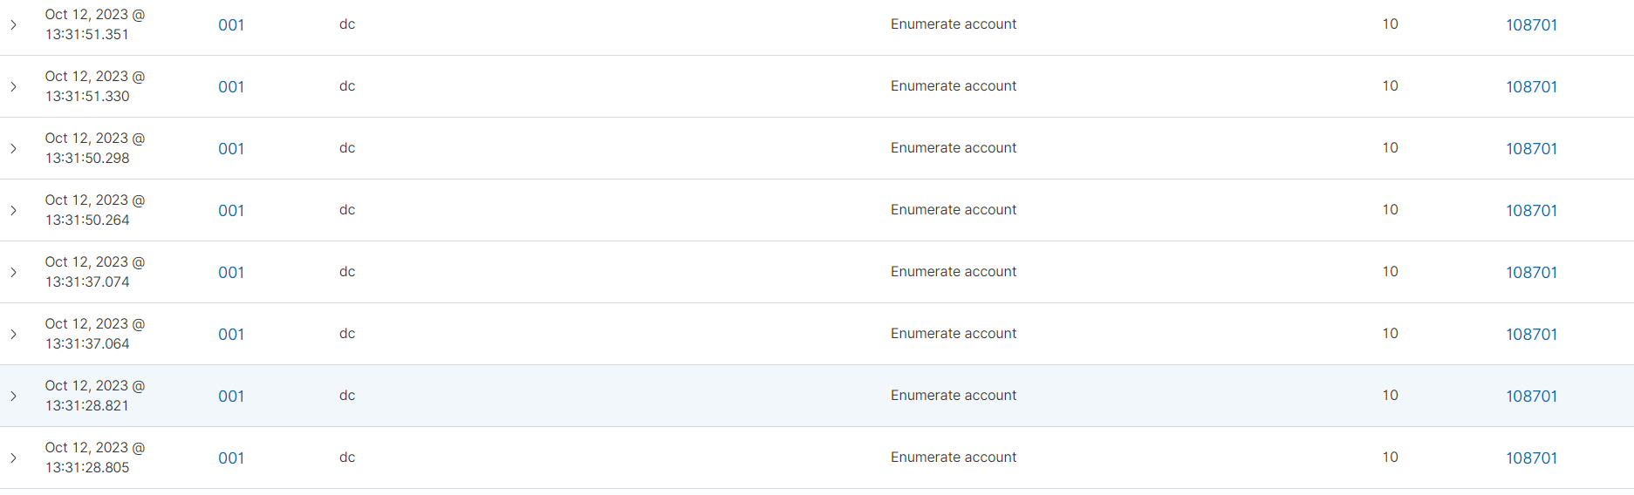
Wazuh Alerts
Here are the multiple alerts generated after invoking the code and emulating the attack.

Slide 8
References

